Slide 1
Implementation of storage as a service specifically for images using web hosting.
Group Members-
Vijay Godhani 27
Harishkandan Somasundaram 30

Slide 2
Introduction
The project implements Storage as a Service by making use of HTML and PHP and some basic CSS for interface.
This project is specific for images.
So a PHP script has been added to ensure that any other type of file is rejected by the system while uploading.
Also, a size limit of roughly 5Mb has been added.
At any point of time, the user can access any single file uploaded.
If he needs all the files together, he can get them too. The files would be downloaded together in a Zip file.

Slide 3
Implementation Details
Languages used were HTML,CSS and PHP.
HTML form was created and buttons were added for choosing,uploading and downloading files.
Basic CSS was used for interface.
PHP scripting was used implementing each modules.
Upload.php for uploading, display.php for displaying details about individual files and making it possible to download them and download.php to download all the files at once in a zip file.

Slide 4
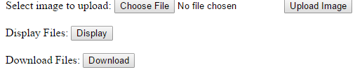
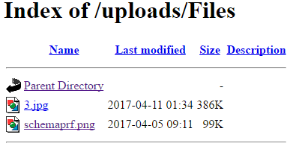

Screenshots

Slide 5

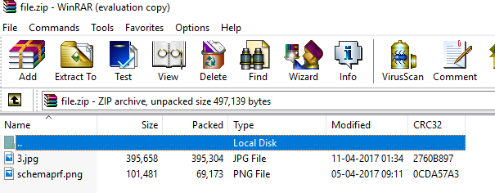
Screenshots(Continued)

Slide 6
Conclusion & References
A cloud storage system for images was successfully implemented and hosted on the web under the domain http://vhfilesharing.comeze.com/ .
References:
www.w3schools.com For syntax
www.stackoverflow.com For error debugging.

